Slide 1
Autogen Profile Insertion Tool Current/Voltage Profile

Slide 2
Outline
Autogen Profile Insertion Tool
Insert current profile instances
Data Analysis
VBT Modification for current/voltage tool
Sample Rate and Sample Size Criteria
Measurement Criteria
Alarm Mechanism
Future
Notice

Slide 3
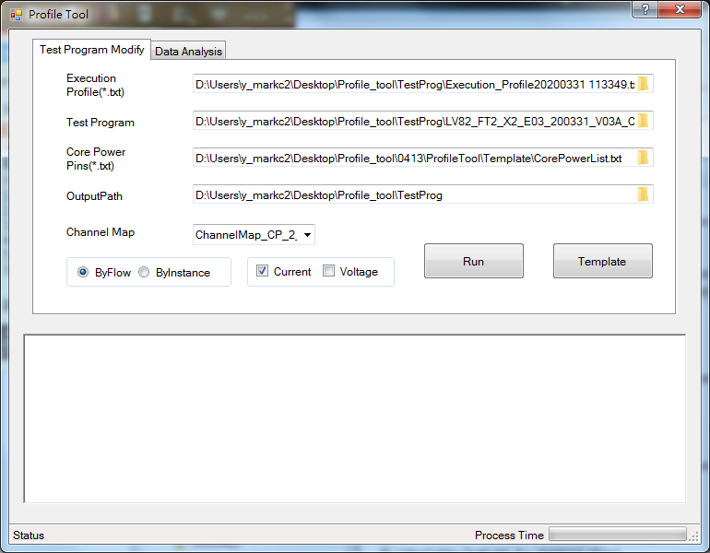
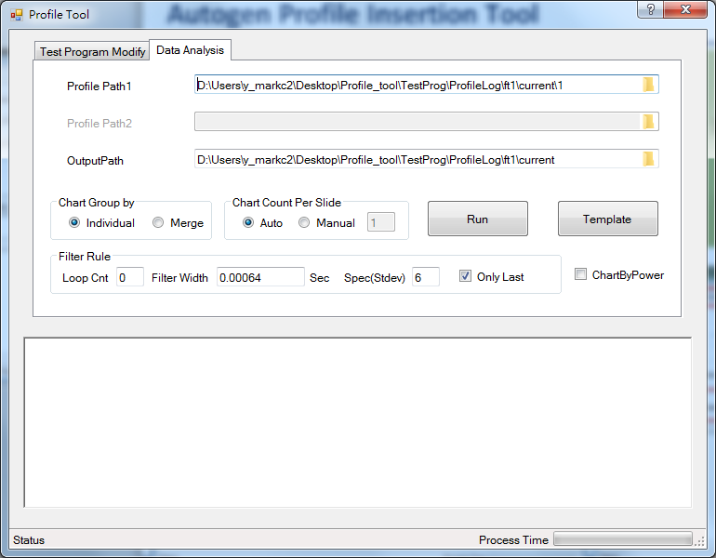
Autogen Profile Insertion Tool
There’re two functions in this tool:
Insert current profile instances in the test program.
Choose the ByFlow or ByInstance to insert the profile’s test instance for each flow table or each test instance independently.
Data Analysis for the current profile output files.
Remove current pulses which are supposed to be caused by the power capacitance.
1
2
Test Program Modify tab
Data Analysis tab

Slide 4
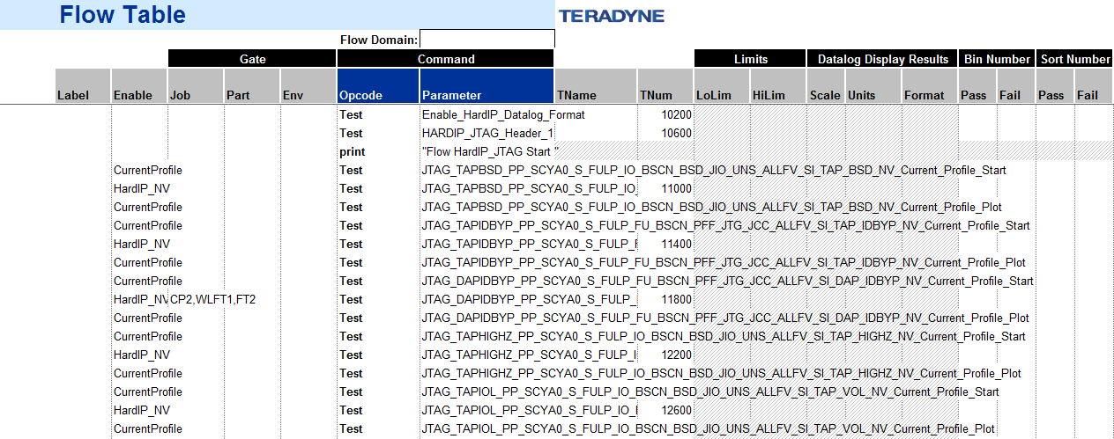
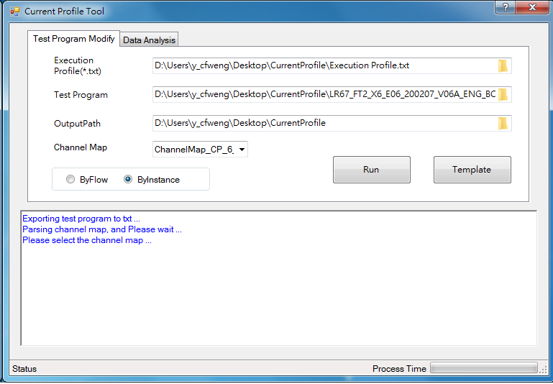
Test Program Modify tab - By Instance
1. Input execution profile, test program and select the Channel Map
2. Choose the button “ByInstance” to insert the profile’s test instance for each test instance.
3. Click button “Run “ to generate a new test program.
1
Start
2
3
Plot
Test Program Modify tab

Slide 5
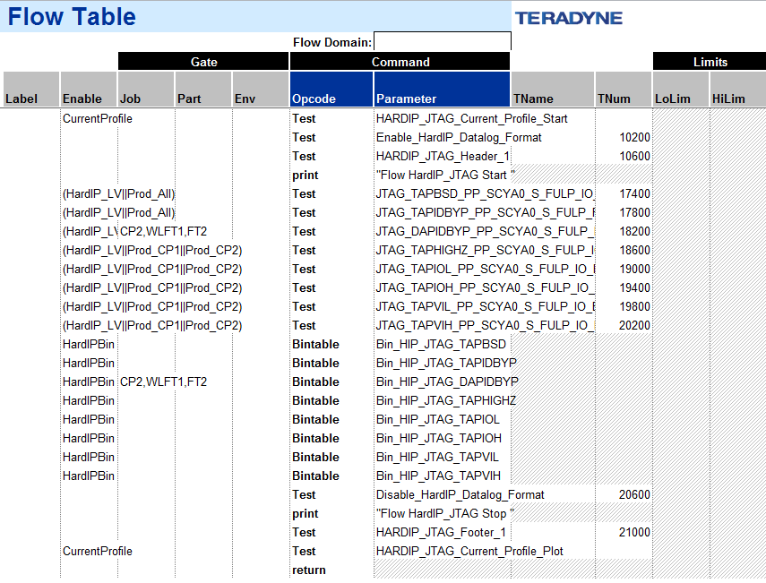
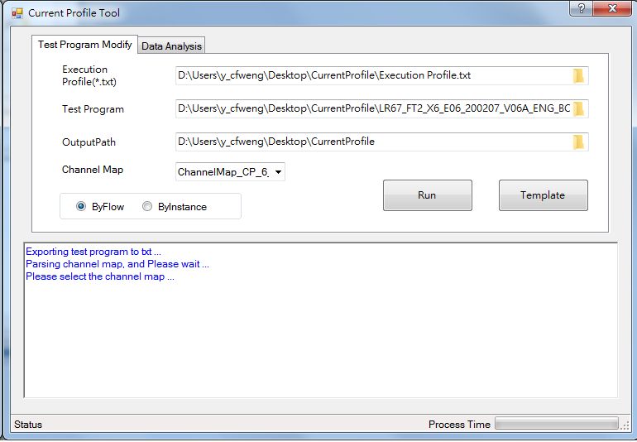
Test Program Modify tab - By Flow
1. Input execution profile, test program and select the Channel Map
2. Choose the button “ByFlow” to insert the profile’s test instance for each flow table.
3. Click button “Run “ to generate a new test program.
1
Start
2
3
Test Program Modify tab
Plot

Slide 6
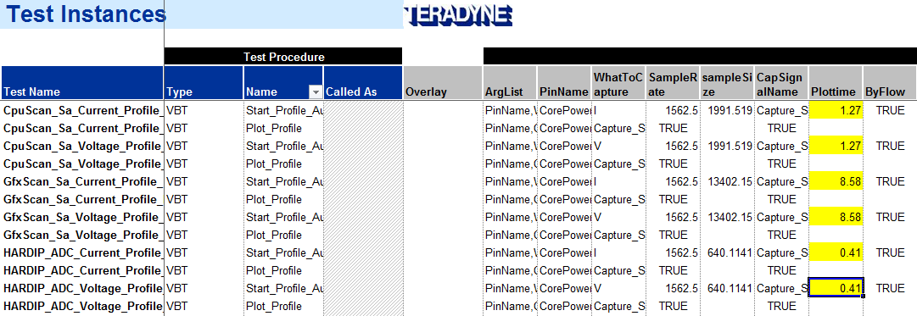
Test Instance Introduction
There are the test instance in the sheet “TestInst_Profile”,
PinName: Define which pin we want to plot.
WhatToCapture: Select current profile(I) or voltage profile(V).
CapSignalName: Give the name for the capture signal.
Plottime: How long we want to capture the signal, the default unit is second.
ByFlow(optional): Show the Flow sheet name in the test log if it is TRUE. Default is False.
SampleRate(optional): Setup the fixed value if Plottime is empty.
SampleSize(optional) : Setup the fixed value if Plottime is empty.

Slide 7
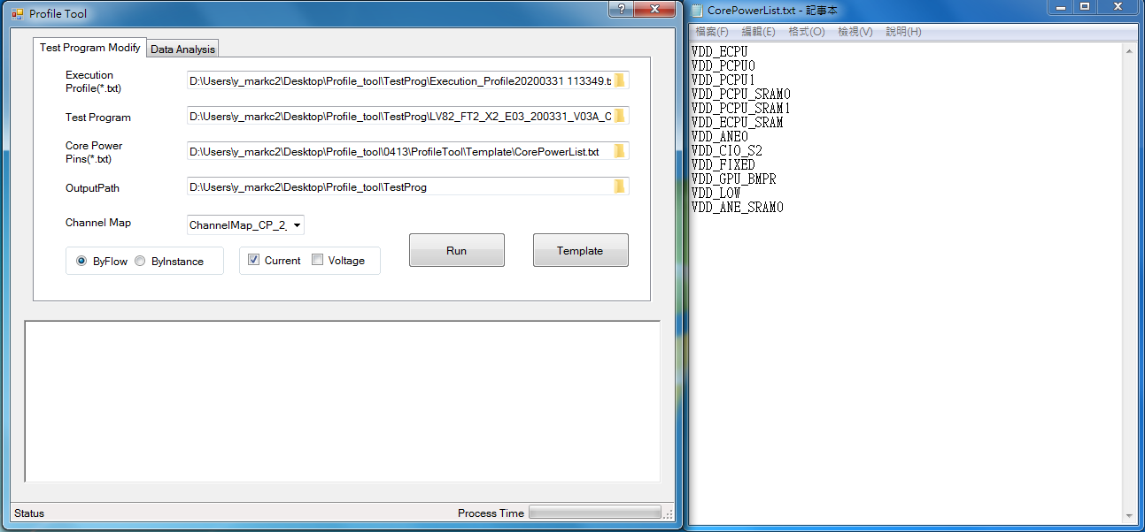
Input Parameter - Core Power Pins(optional)
With the user-definition file, the measurement power pin will follow the list and append the specified power pins which is measured in the flow.
Without the file, the measurement power pin will list all the power pin whose instrument is DCVS.

Slide 8
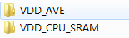
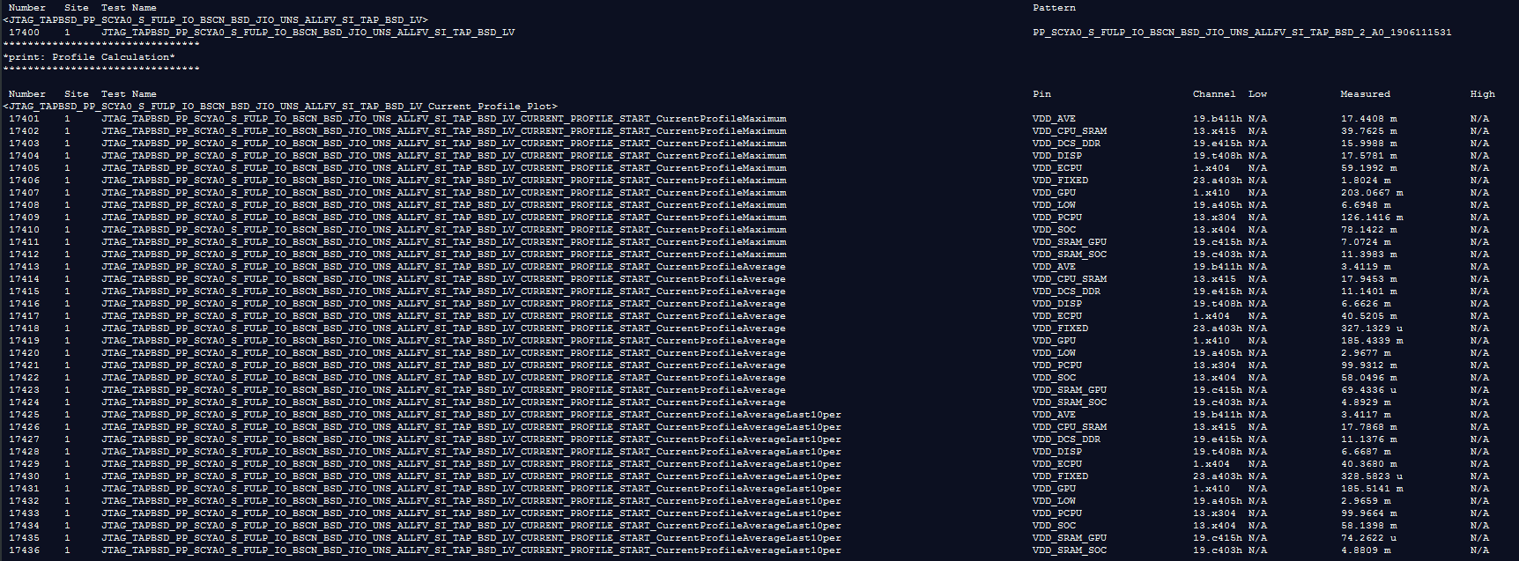
By Instance - Export File Naming Rule & Test Log
File name need to follow the rule.
Profile – Site – Pin – Sample rate – Sample Size – [By Instance]– DayCode.txt
Analyze the data to find the maximum, average and AverageLast10per.
Test log needs to follow the rule.
[By Instance]_CurrentProfile[Maximum/Average/AverageLast10per]
By Instance
By Instance

Slide 9
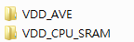
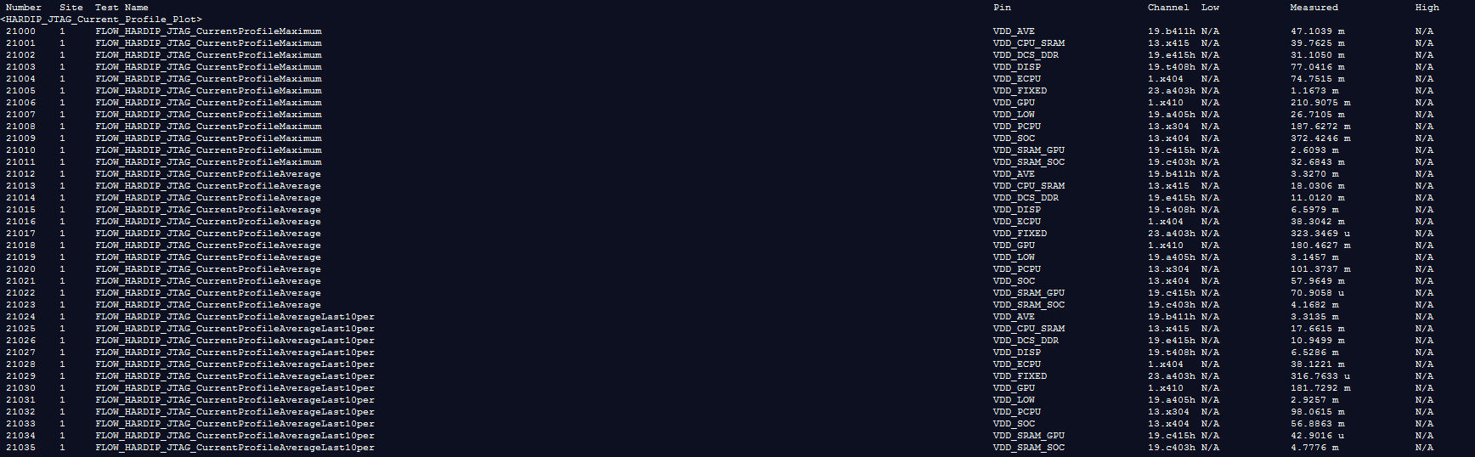
By Flow - Export File Naming Rule & Test Log
File name need to follow the rule.
Profile – Site – Pin – Sample rate – Sample Size – [By Flow]– DayCode.txt
Analyze the data to find the maximum, average and AverageLast10per.
Test log need to follow the rule.
[By Flow]_CurrentProfile[Maximum/Average/AverageLast10per]
By Flow
By Flow

Slide 10
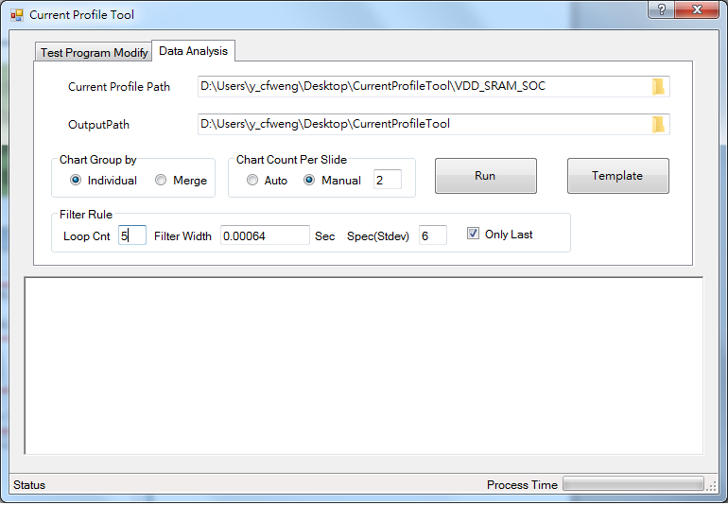
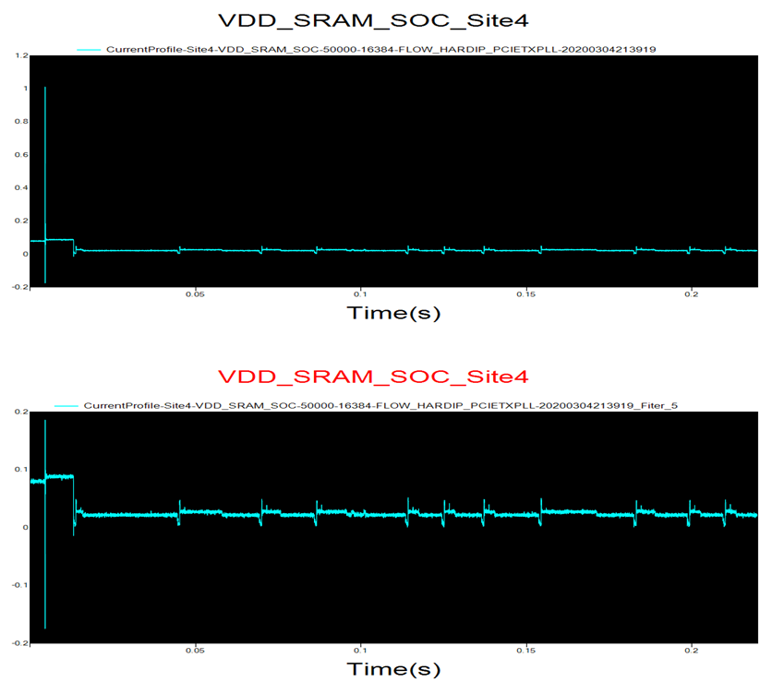
Data Analysis tab – Chart Group by Individual
1. Input the current profile path which stores the per each pin’s data collection.
2. Choose the “individual”, it produces the single graph per each exporting profile file and store in the power point report.
3. Filter rule to select the customized configurations to remove the unwanted pulse. It shows two graphic, one is the original and the other is modified one in the power point report and the raw data will be saved in the excel.
1
2
3
3. Filter Rule Introduction
a. Loop Cnt: How many times to remove the unwanted pulse.
b. Filter Width: To remove the pulse whose width is lower than the Filter Width.
c. Sepc(Stdev): Filer Criteria to find the 100 points on the left and right sides of the pulse, and calculation the standard deviation.
d. Only Last: Show the original graph and the graph which removed the unwanted pulse in the last Loop Cnt.
Remove the unwanted pulse caused by capacitor

Slide 11
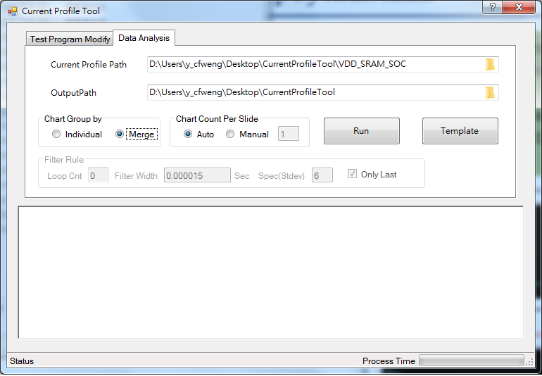
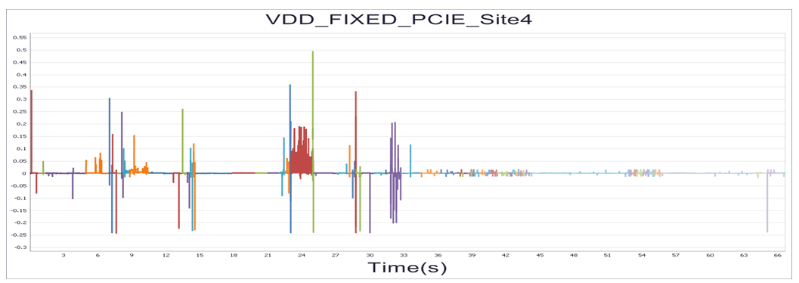
Data Analysis tab – Chart Group by Individual
1. Input the current profile path which stores the per each pin’s data collection.
2. Choose the “Merge”, it composites all the single graph per each exporting profile file and store in the power point report.
1
2

Slide 12
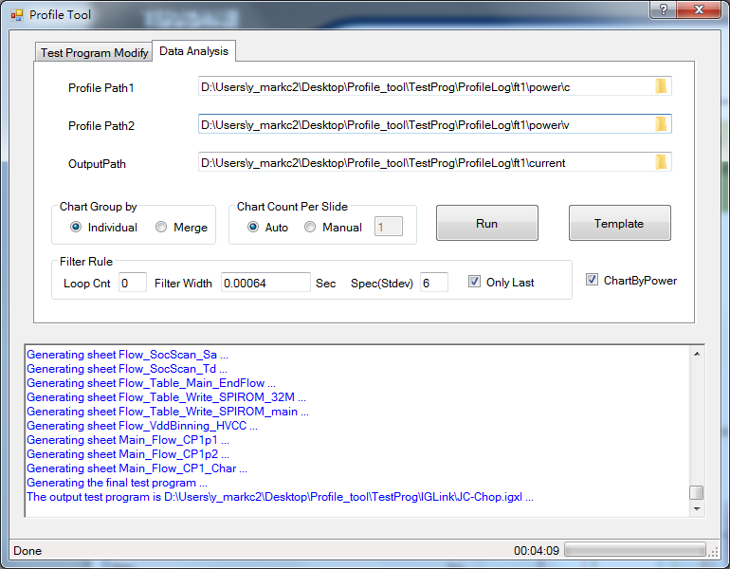
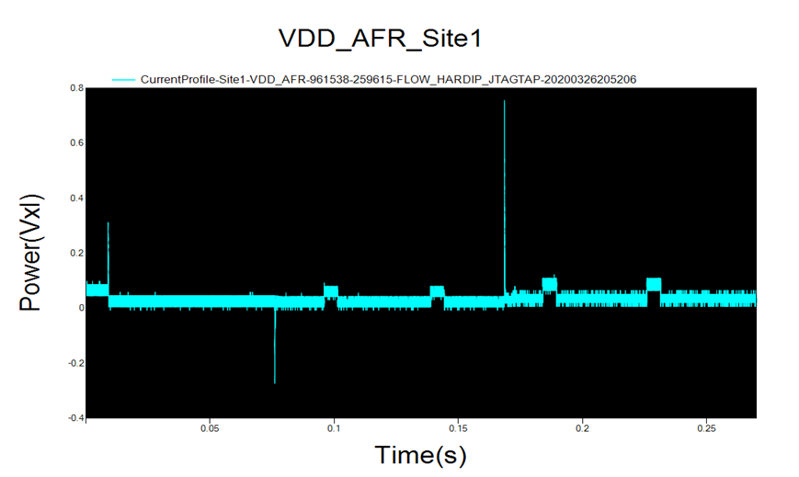
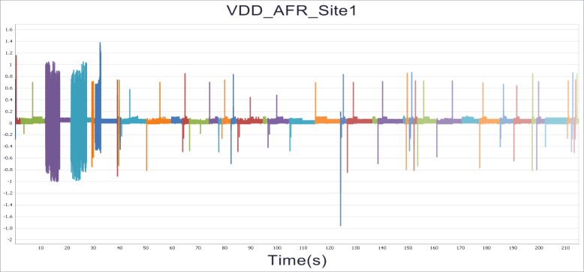
Data Analysis tab – Power Consumption
1. Select “ChartByPower”, you should input current profile path both current and voltage .
2. Choose the output format, “Individual” or “Merge”,
1
2
1

Slide 13
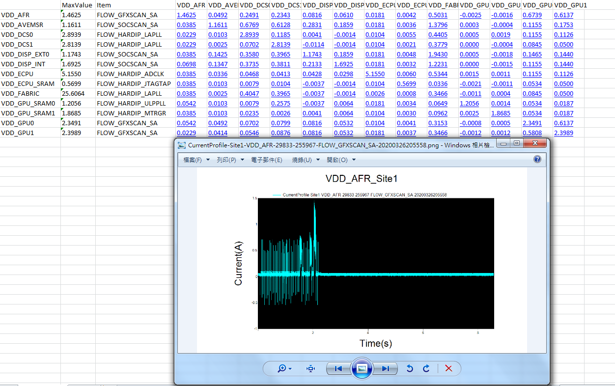
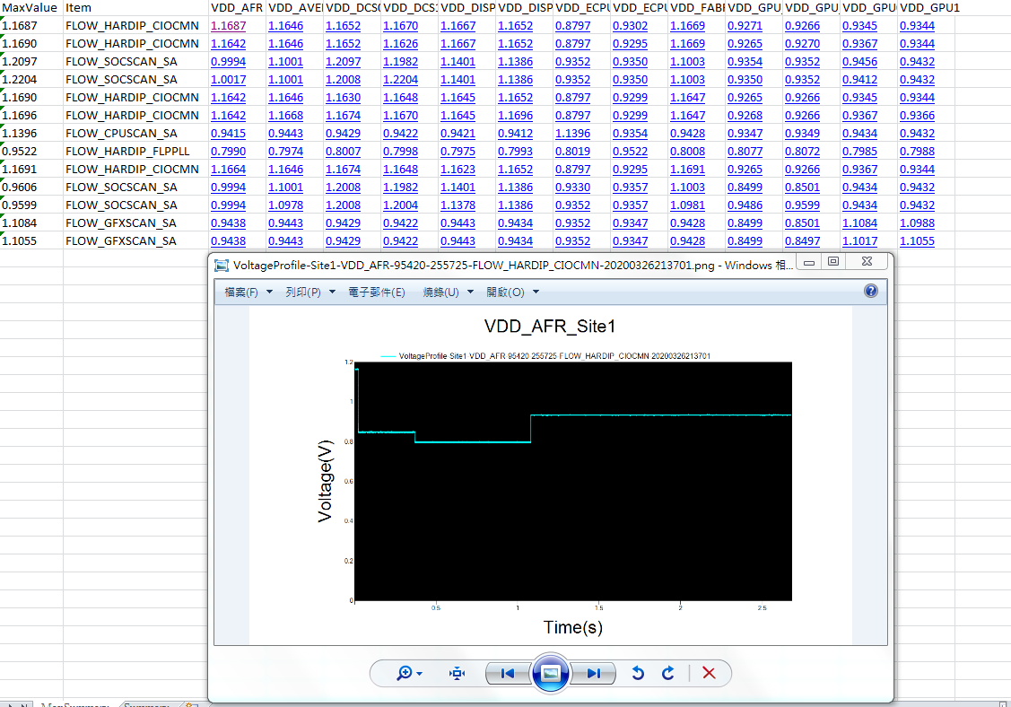
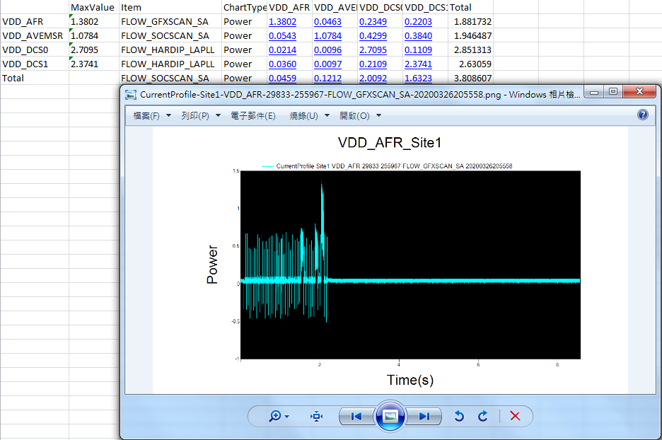
Data Analysis tab – MaxSummary

Slide 14
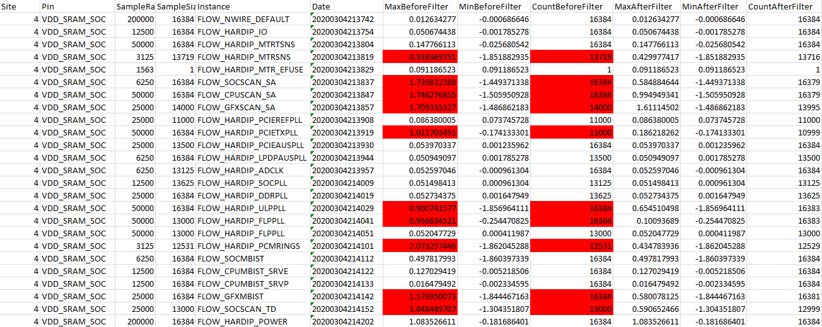
Data Analysis tab – conti.

Slide 15
VBT Modification for current/voltage tool
VBT Modification for current/voltage tool
Sample Rate and Sample Size Criteria
Measurement Criteria
Alarm Mechanism

Slide 16
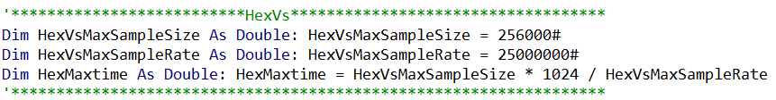
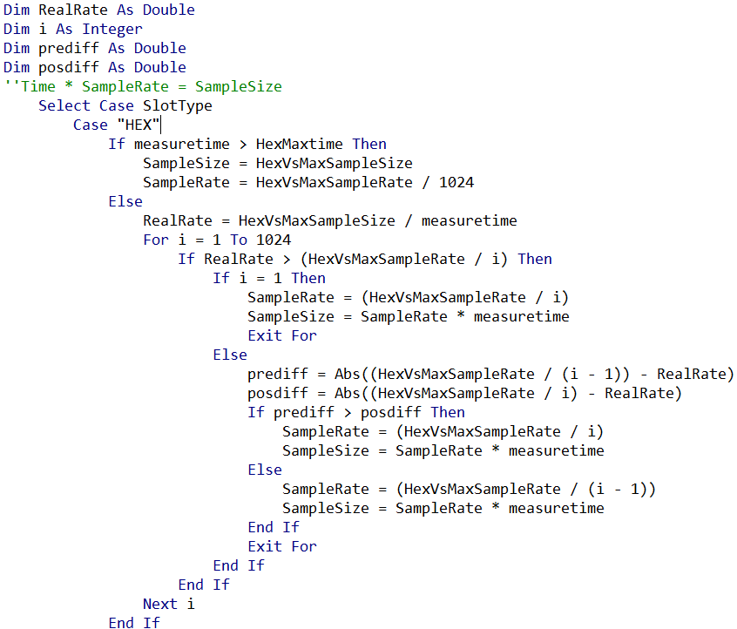
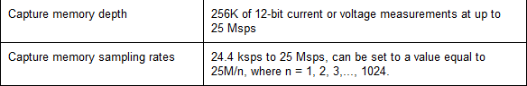
Sample Rate and Sample Size Criteria
1. If the plottime is larger than the limitation of instrument, the sample size and sample rate will be the maximal one of instrument .
2. If the plottime is smaller than the limitation of instrument, it will obtain the current sampling rate. Then, find the optimal sampling rate by looping the size of degree and calculate the optimal sampling size.
1
2

Slide 17
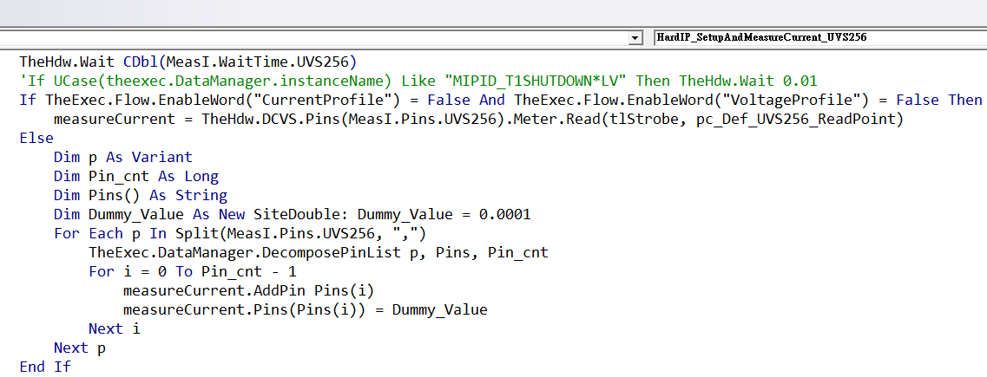
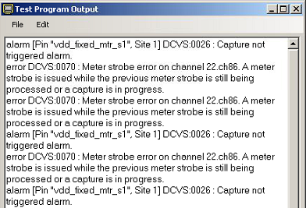
Measurement Criteria
Bypass the power pin’s current measurement while we are profiling current or voltage that power pin.
Note: error DCVS:0070 will occur because the instrument can not capture and meter strobe at the same time.

Slide 18
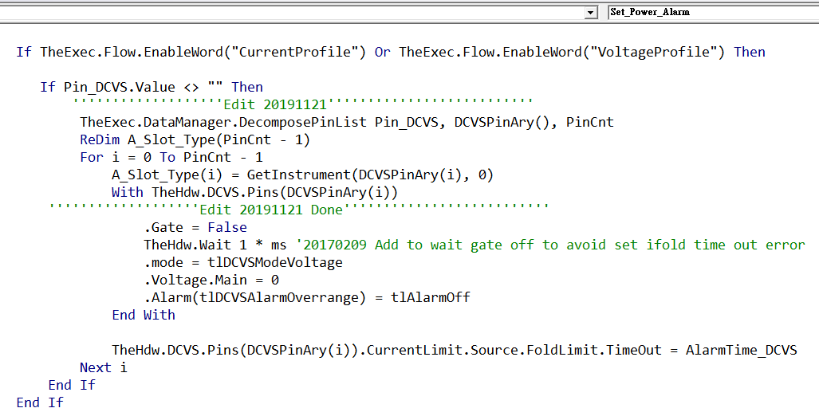
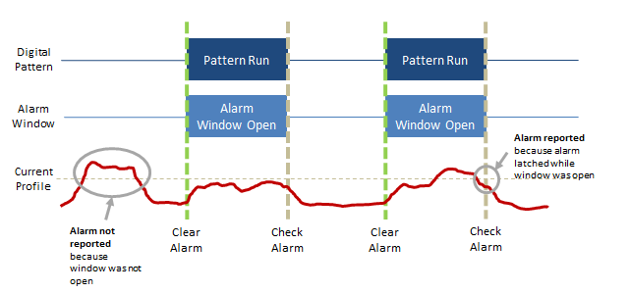
Alarm Mechanism
Bypass the overrange alarm while we are profiling current or voltage that power pin.
Note: alarm DCVS:0075 overrange alarm happened because the alarm window open during the instrument measurement when the voltage translation.

Slide 19
Notice
System Memory Limitation
Header/Footer mismatch with Flow sheet name
Ex: Header: SocSa_Header_1 , Flow sheet name: Flow_SocScan_Sa
Miss Header/Footer at BinCut Flow in Project T-sic, but they exist after Project T-sic.

